Slide 1
Miller Collection of Early United States Silver Dollars 1794-1803
W. David Perkins
FUN 2016

Slide 2
Miller Collection
Started in 1983
Complete with all 118 known die marriages in early 2006
169 Early Dollars total
Error Coins (Double / Triple Struck, etc.)
# PCGs Registry Set – Date and Extended Type
Two new die marriages discovered in 2015

Slide 3
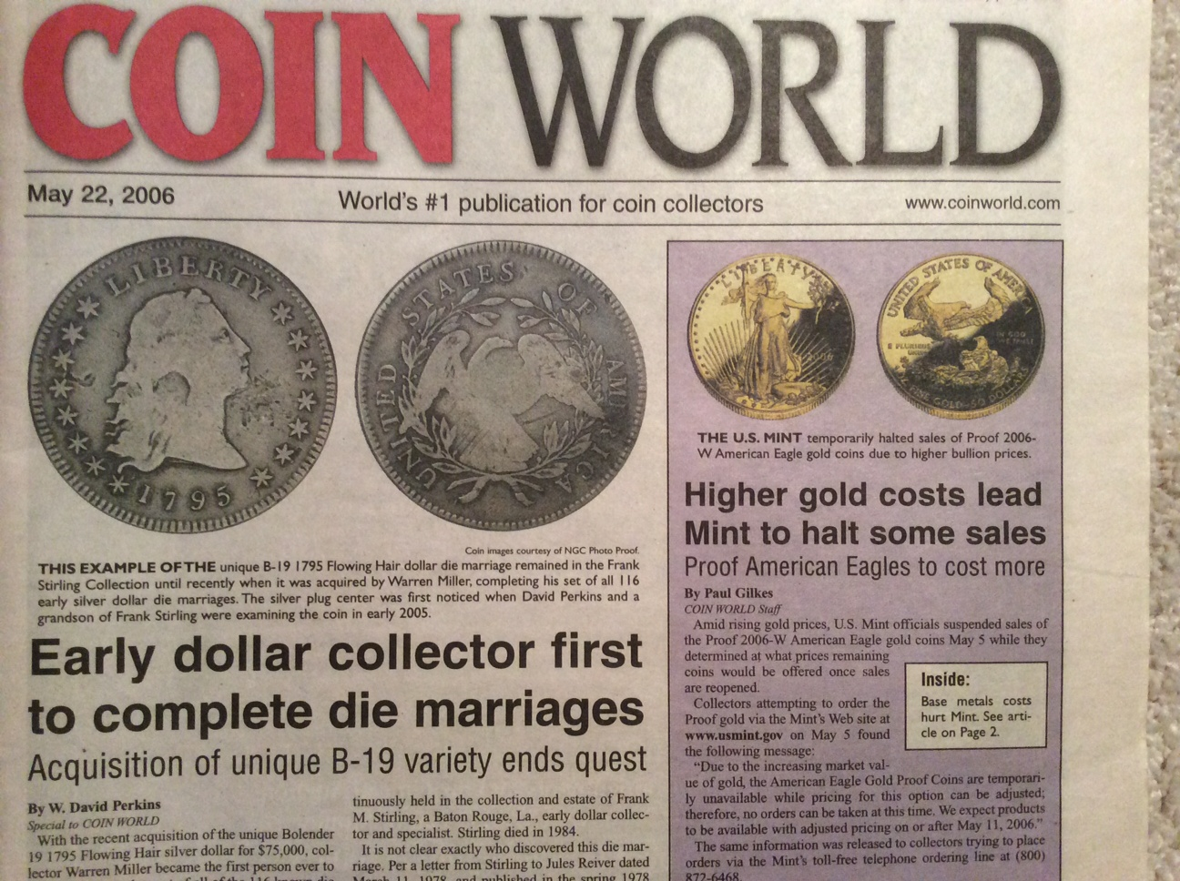

Slide 4
1796 B-6, BB-64 (3 Known)

Slide 5
1797 Triple Struck Dollar

Slide 6
1798 B-16, BB-110, R-6+ LDS Bolender Plate Coin

Slide 7
1800 Wide Date, Low 8 AMERICAI Finest Known and Only MS

Slide 8
1803 Large 3 P58+

Slide 9
Collection Purchased by Perkins & Lustig
Collection purchased in Fall 2015
Remaining Coins for sale can be seen at Tables 1034 and 1036
Contact Dave at wdperki@attglobal.net or Cell 303-902-5366 for listing, prices, etc.

